Slide 1
Create Performance Task
Row 2 - Data Abstraction

Slide 2
Instructions
You can only use this version if you can write on a pdf, otherwise please use the ppt version.
Read the criteria for this row on slides 3 - 4.
For each response (slides 5 – 14):
  Underline any code, phrases or sentences that meet any of the criteria.
  Tick (✔) any criteria that are satisfied and cross (✘) any criteria that are not satisfied.
  Write a 1 in the bottom right corner if the response gets the mark for this row (all criteria have been satisfied), otherwise write a 0.
When finished, save this presentation as a pdf with 2 slides to a page and submit this file.

Slide 3
Scoring Criteria
includes two program code segments:
  one that shows how data has been stored in this list (or other collection type).
  one that shows the data in this same list being used as part of fulfilling the program’s purpose.
identifies the name of the variable representing the list being used in this response.
describes what the data contained in this list is representing in the program.

Slide 4

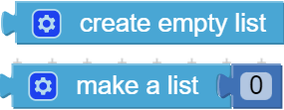
Decision Rules
Consider ONLY written response 3b when scoring this point.
Requirements for program code segments:
  The written response must include two clearly distinguishable program code segments, but these segments may be disjointed code segments or two parts of a contiguous code segment.
  If the written response includes more than two code segments, use the first two code segments to determine whether or not the point is earned.
Do NOT award a point if any one or more of the following is true:
  The list is a one-element list.
  The use of the list does not assist in fulfilling the program’s purpose.
The list must not be empty or only have 1 element.
e.g. Neither of the following are acceptable:
One way round this would be to write:
However, there would normally be a point where actual required data is added to the list and another point where the list is subsequently used, so I suggest using those code segments instead.

Slide 5
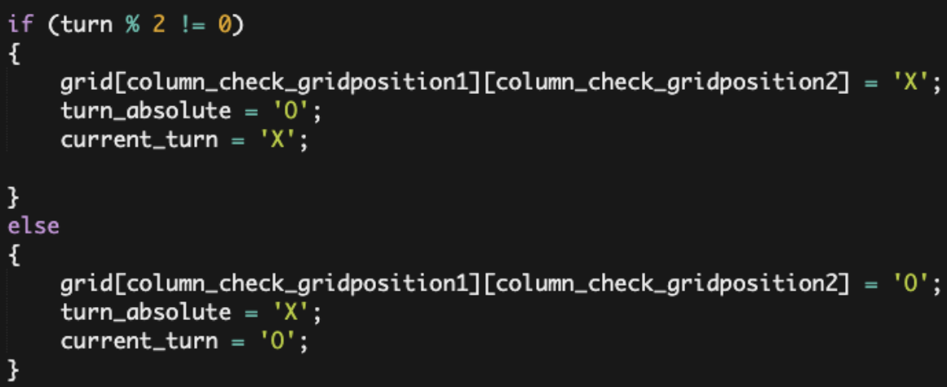
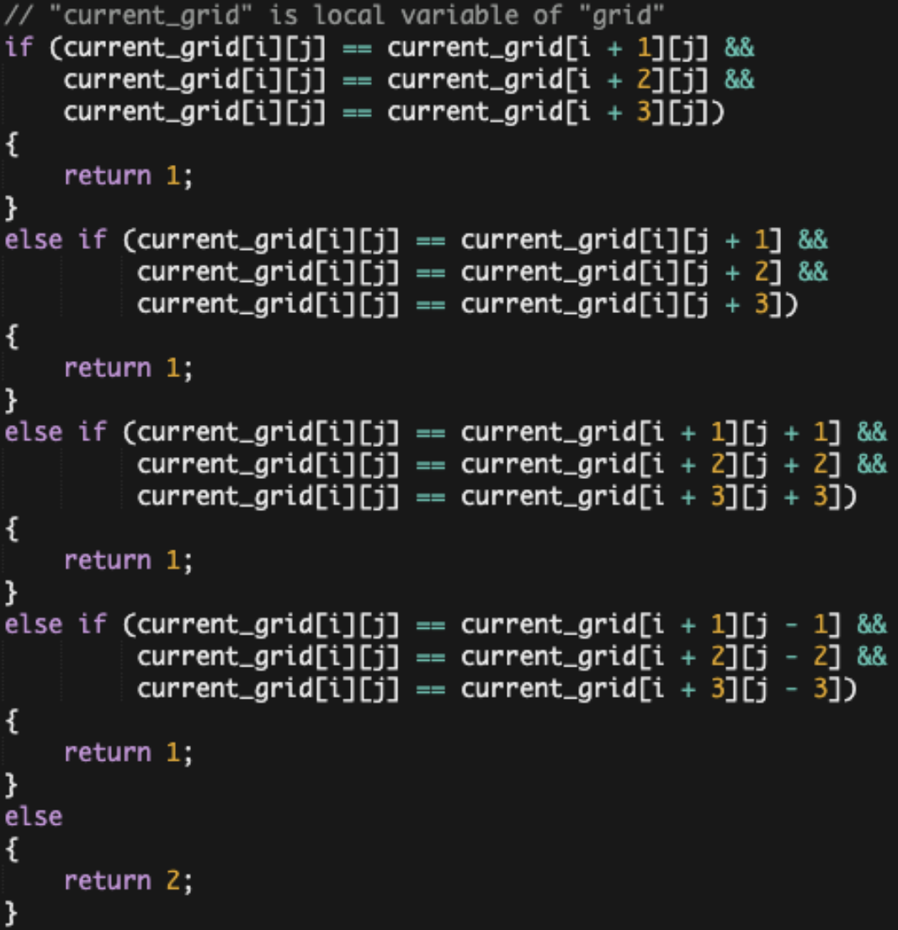
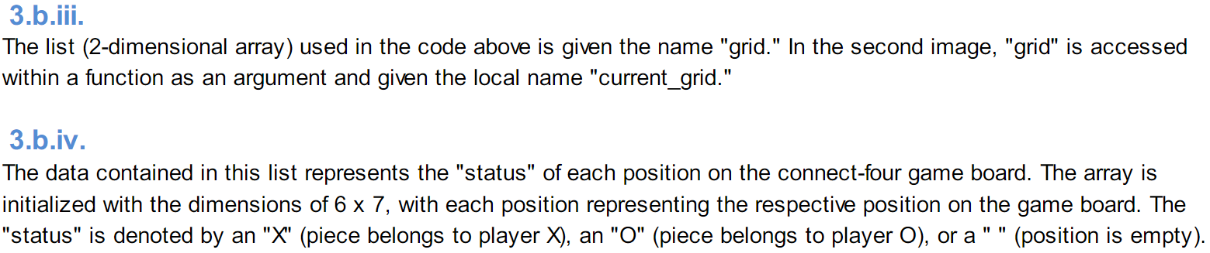
a
includes two program code segments:
  one that shows how data has been stored in this list (>1 element).
  one that shows the data in this same list being used as part of fulfilling the program’s purpose.
identifies the name of the variable representing the list being used in this response.
describes what the data contained in this list is representing in the program.
?

Slide 6
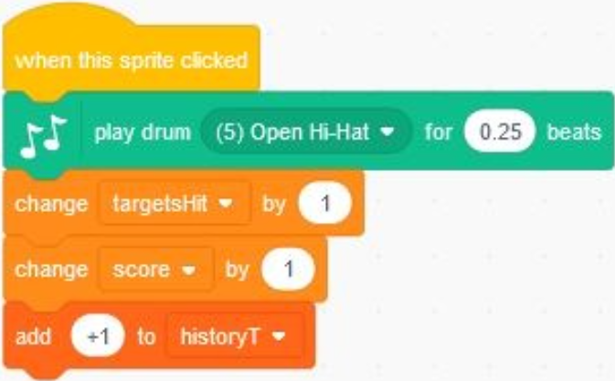
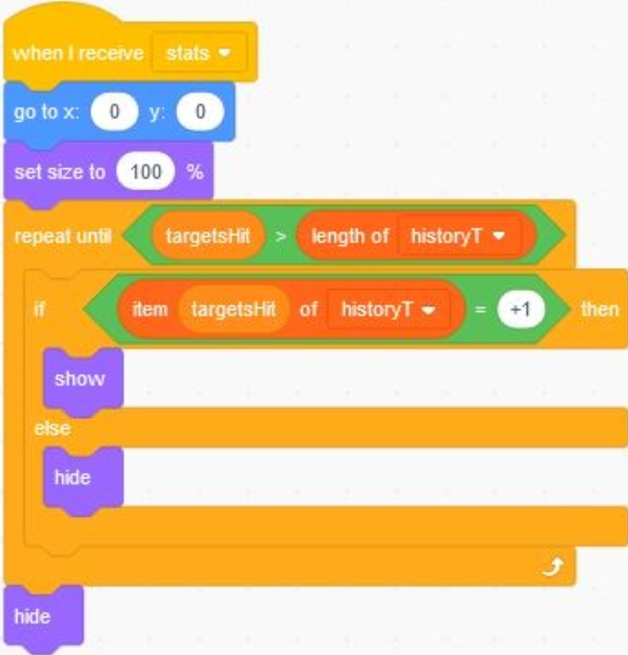
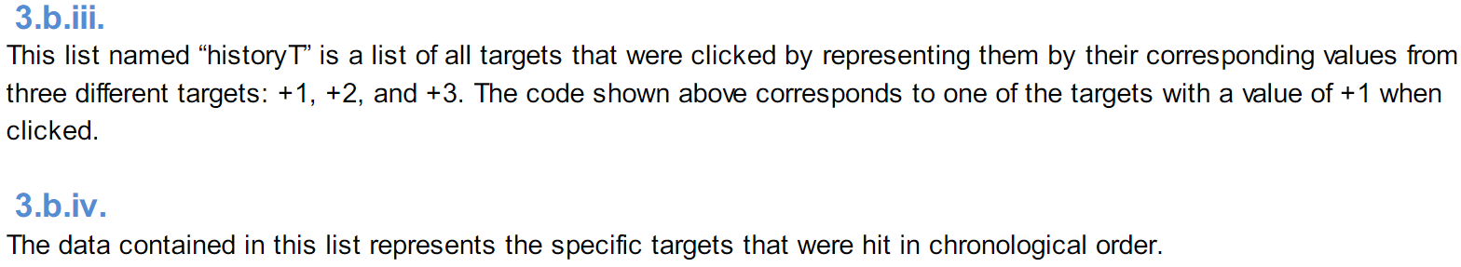
b
includes two program code segments:
  one that shows how data has been stored in this list (>1 element).
  one that shows the data in this same list being used as part of fulfilling the program’s purpose.
identifies the name of the variable representing the list being used in this response.
describes what the data contained in this list is representing in the program.
?

Slide 7
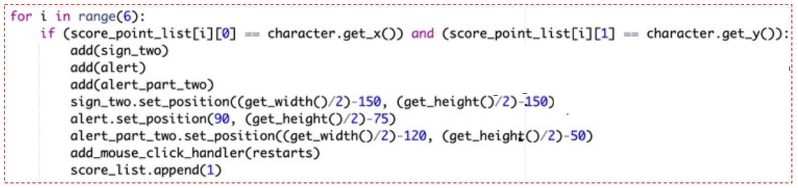
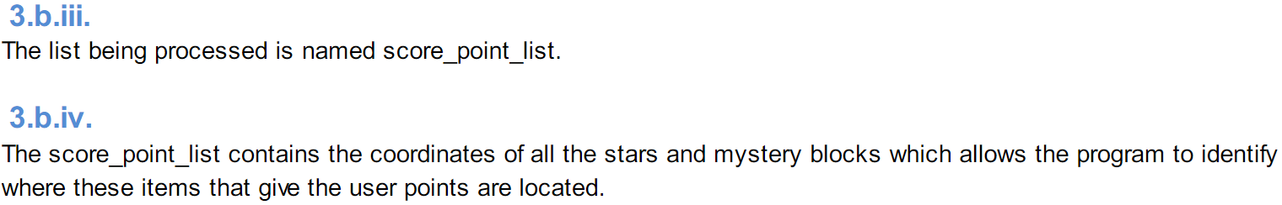
c
includes two program code segments:
  one that shows how data has been stored in this list (>1 element).
  one that shows the data in this same list being used as part of fulfilling the program’s purpose.
identifies the name of the variable representing the list being used in this response.
describes what the data contained in this list is representing in the program.
?

Slide 8
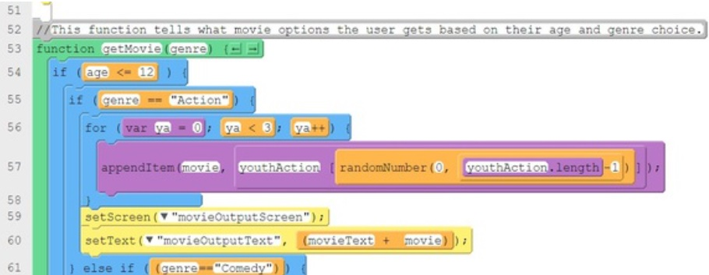
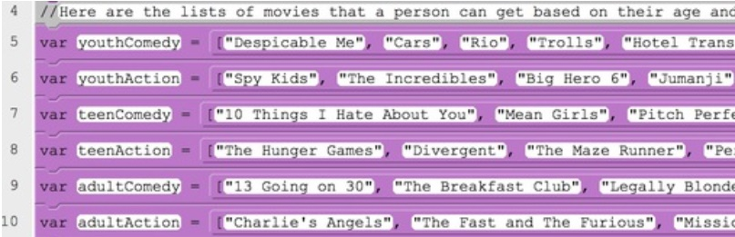
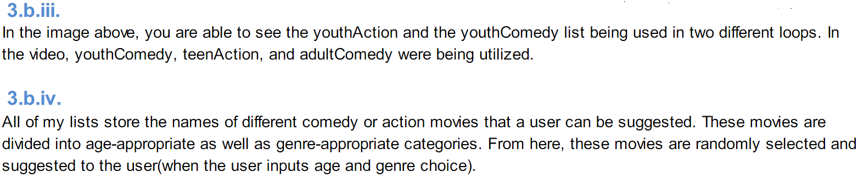
d
includes two program code segments:
  one that shows how data has been stored in this list (>1 element).
  one that shows the data in this same list being used as part of fulfilling the program’s purpose.
identifies the name of the variable representing the list being used in this response.
describes what the data contained in this list is representing in the program.
?

Slide 9
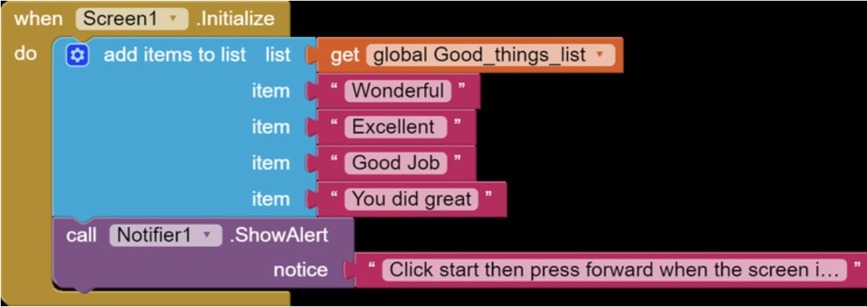
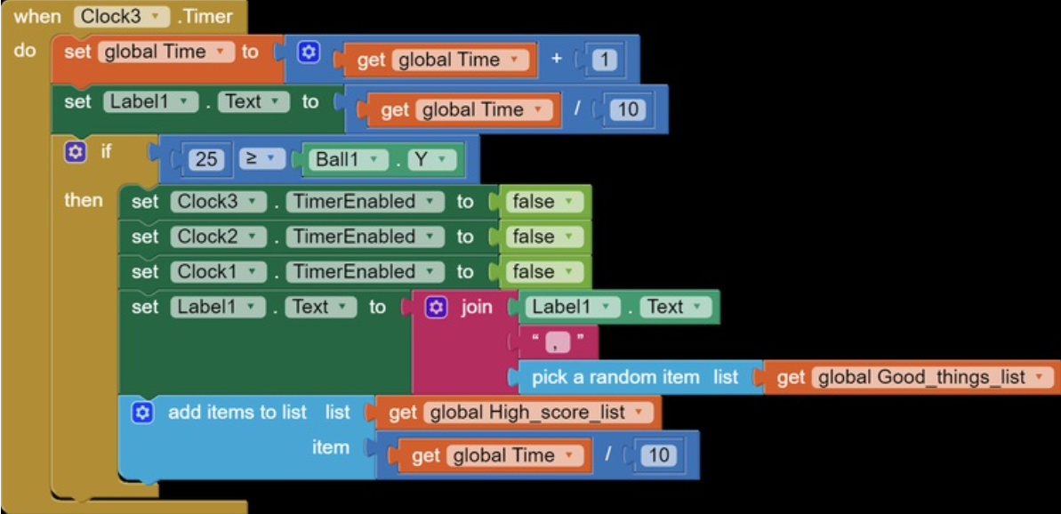
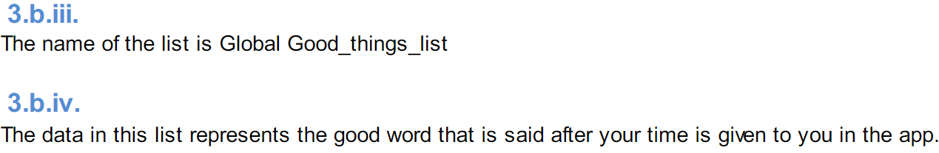
e
includes two program code segments:
  one that shows how data has been stored in this list (>1 element).
  one that shows the data in this same list being used as part of fulfilling the program’s purpose.
identifies the name of the variable representing the list being used in this response.
describes what the data contained in this list is representing in the program.
?

Slide 10
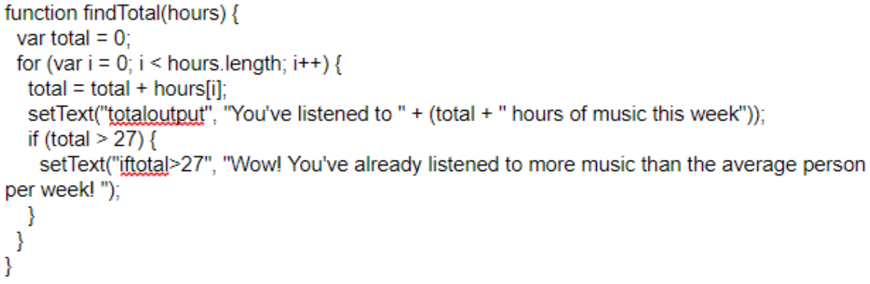
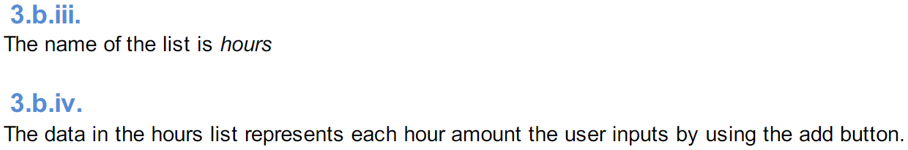
f
includes two program code segments:
  one that shows how data has been stored in this list (>1 element).
  one that shows the data in this same list being used as part of fulfilling the program’s purpose.
identifies the name of the variable representing the list being used in this response.
describes what the data contained in this list is representing in the program.
?

Slide 11
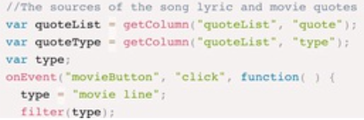
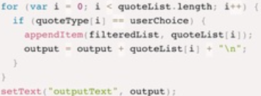
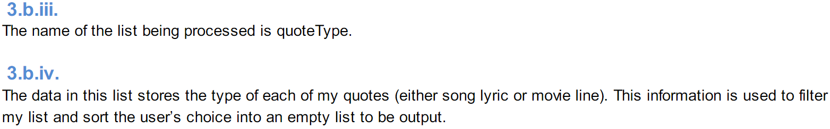
g
includes two program code segments:
  one that shows how data has been stored in this list (>1 element).
  one that shows the data in this same list being used as part of fulfilling the program’s purpose.
identifies the name of the variable representing the list being used in this response.
describes what the data contained in this list is representing in the program.
?

Slide 12
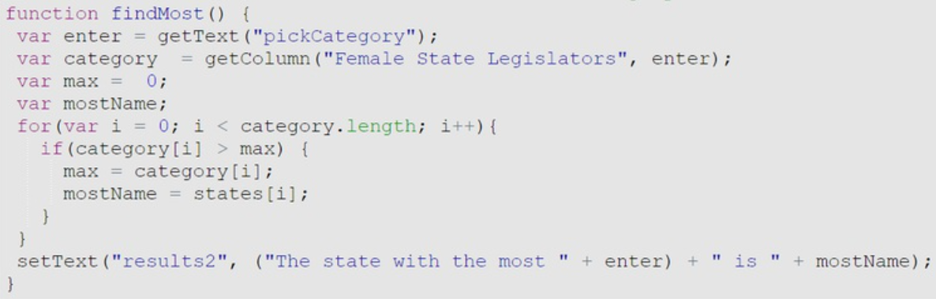
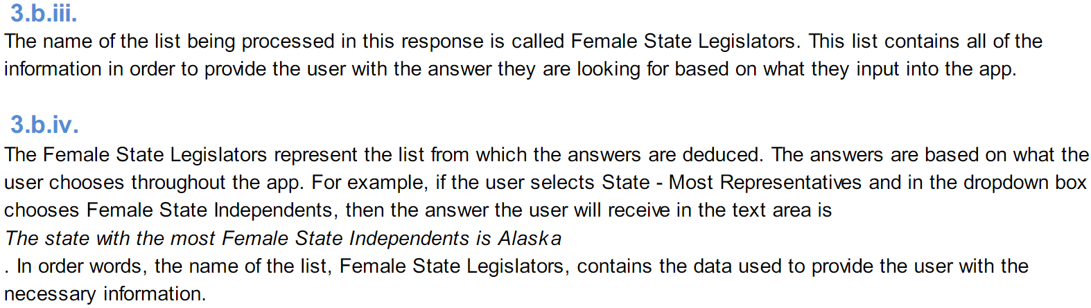
h
includes two program code segments:
  one that shows how data has been stored in this list (>1 element).
  one that shows the data in this same list being used as part of fulfilling the program’s purpose.
identifies the name of the variable representing the list being used in this response.
describes what the data contained in this list is representing in the program.
?

Slide 13
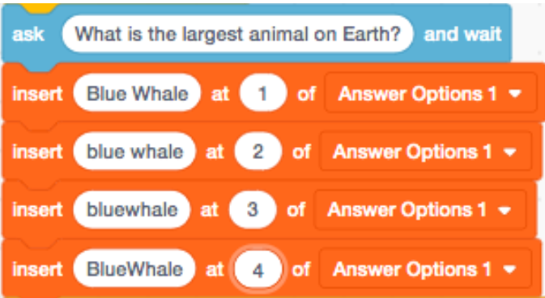
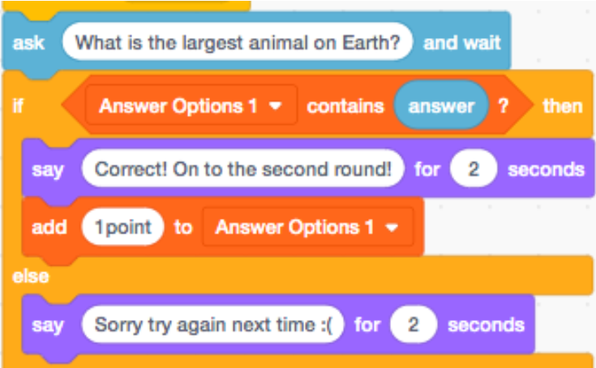
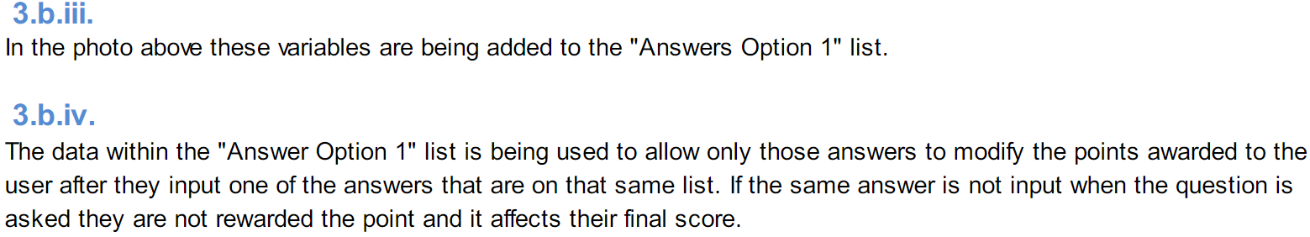
i
includes two program code segments:
  one that shows how data has been stored in this list (>1 element).
  one that shows the data in this same list being used as part of fulfilling the program’s purpose.
identifies the name of the variable representing the list being used in this response.
describes what the data contained in this list is representing in the program.
?

Slide 14
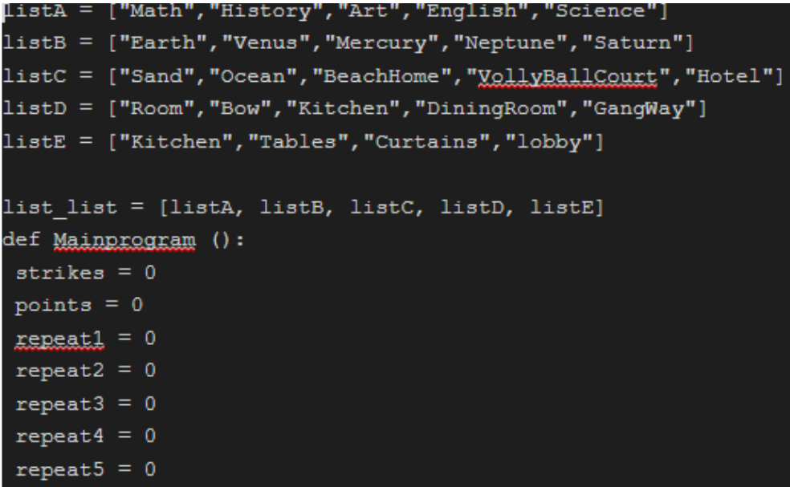
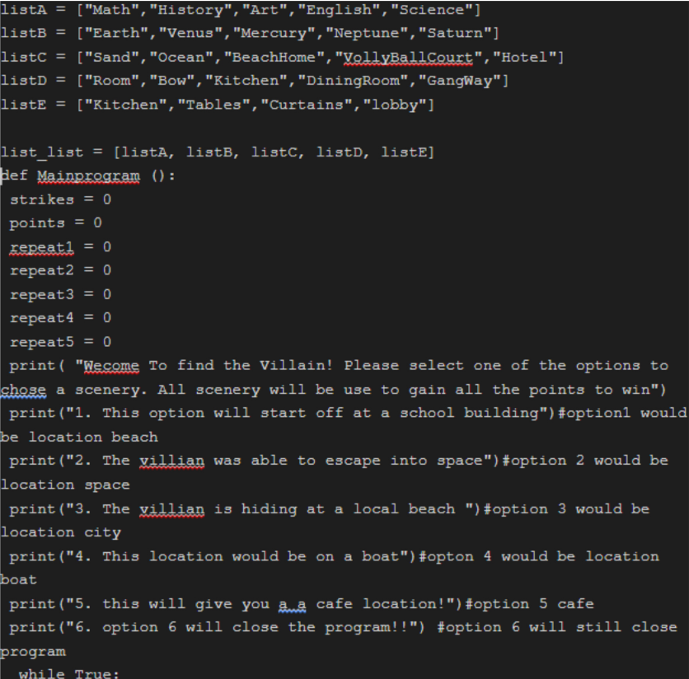
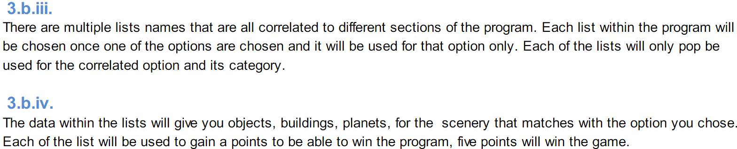
j
includes two program code segments:
  one that shows how data has been stored in this list (>1 element).
  one that shows the data in this same list being used as part of fulfilling the program’s purpose.
identifies the name of the variable representing the list being used in this response.
describes what the data contained in this list is representing in the program.
?

